Slide 1

The new CoM EU SECAP guidebook: guidance on adaptation actions
Workshop: How to develop a comprehensive adaptation project: adaptation and nature-based solutions
Paula Bezerra, Joint Research Centre, Energy efficiency and renewables unit (C.2)
13 October 2025

Slide 2
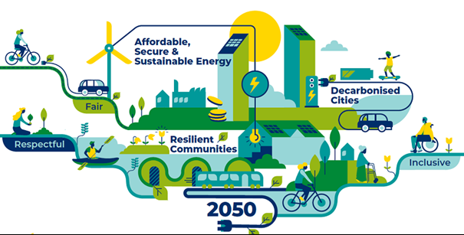
Covenant of Mayors initiative
The EU Covenant of Mayors for Climate & Energy is an initiative supported by the European Commission bringing together thousands of local governments that want to secure a better future for their citizens.
A unique bottom-up movement bringing together local and regional authorities voluntarily committed to implementing EU Climate & Energy objectives on their territories.
Launched in 2008 with a single target in reducing GHG emissions by 20%, it changed through time, to incorporate and update for the new reality and new EU policies
Source: Covenant of Mayors - Europe | Covenant of Mayors - Europe (europa.eu)

Slide 3
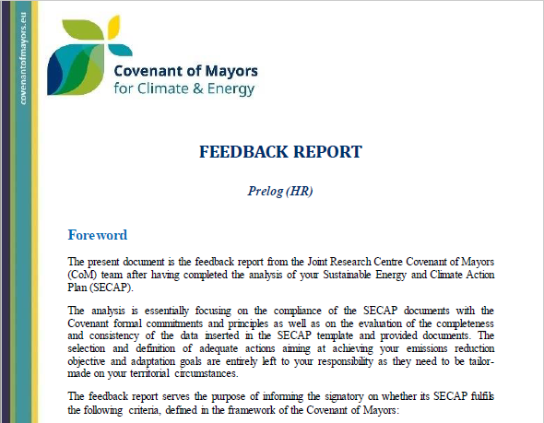
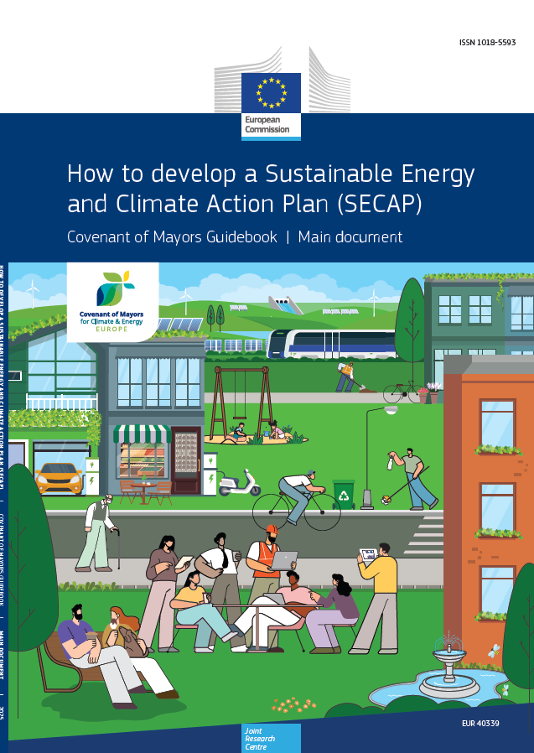




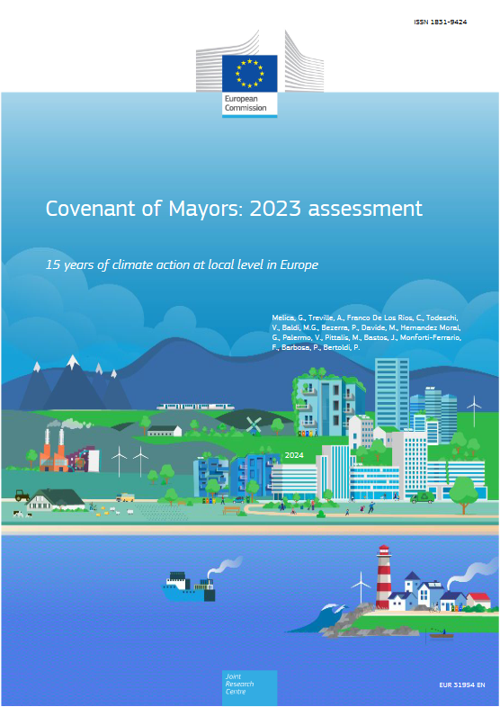
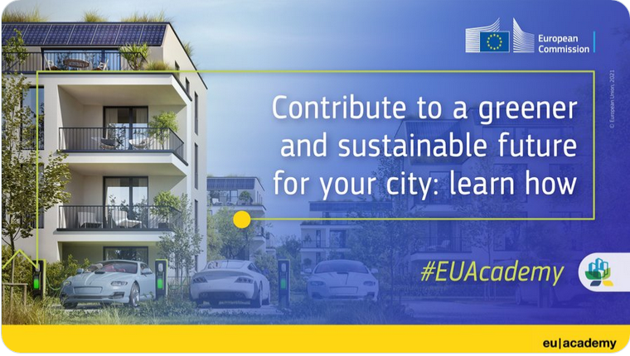



Role of the JRC in the Covenant
The Joint Research Centre (JRC) is the in-house science and knowledge service of the European Commission.
Plans evaluation
Methodological basis (Guidebooks & tools)
Methodological adaptation to
world regions
Data
Trainings & capacity building
Overall assessment
Helpdesk & technical support

Slide 4

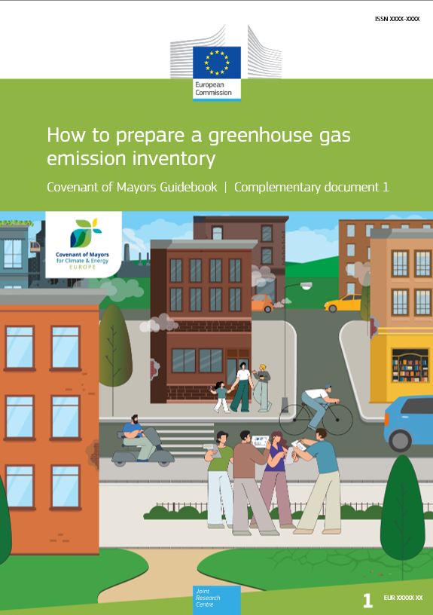




Main novelties
Updated EU climate and energy policy context
A section dedicated to regulatory provisions relevant to local climate action
New guidance on how to account GHG emissions from waste
More detailed guidance on risks and vulnerability assessment and adaptation goals
New guidance on energy poverty assessment
Document on how to plan actions, incl. numerous examples, indicators, considerations related to co-benefits
Comprehensive guidance on financial mechanisms to implement SECAP actions

Slide 5
The basis of the adaptation actions

Slide 6
Role of the municipalities
Modes of urban climate governance
Types of actions
MUNICIPAL SELF GOVERNING
INVESTMENTS IN MUNICIPALITY OWNED ASSETS OR INFRASTRUCTURES
GREY OPTIONS
PHYSICAL AND TECHNOLOGICAL
TECHNOLOGICAL OPTIONS
GREEN OPTIONS
BLUE OPTIONS
GOVERNING THROUGH PROVISION
PROVIDING SERVICES AND FINANCIAL RESOURCES
FINANCING AND INCENTIVE INSTRUMENTS
ECONOMIC AND FINANCE
INSURANCE AND RISK SHARING INSTRUMENTS
REGULATION AND PLANNING
REQUIREMENTS AND GUIDANCE
INFLUENCE
POLICIES AND REGULATIONS
GOVERNANCE AND INSTITUTIONAL
MANAGEMENT AND PLANNING
COORDINATION, COOPERATION AND NETWORKS
GOVERNING THROUGH ENABLING
FACILITATING CO-OPERATION AMONG STAKEHOLDERS & AWARENESS BUILDING
INFORMATION AND AWARENESS RAISING
KNOWLEDGE AND BEHAVIOUR CHANGE
CAPACITY BUILDING, EMPOWERING & LIFESTYLE
Note: the links among modes of urban climate governance and types of actions are non-exhaustive. Multiple types of actions can be triggered through each mode of urban climate governance.

Slide 7
The basis of adaptation actions
How we will mitigate climate risks and vulnerabilities and reduce potential impacts!
SECAP
INITIATION
STATUS QUO ASSESSMENT AND GOALS
ACTION PLANNING AND STRATEGIES
IMPLEMENTATION & MONITORING
RVA
Adaptation goal
UNDERSTAND
PLANNING ACTIONS
PREPARING FOR
IMPLEMENTATION
EXECUTE

Slide 8
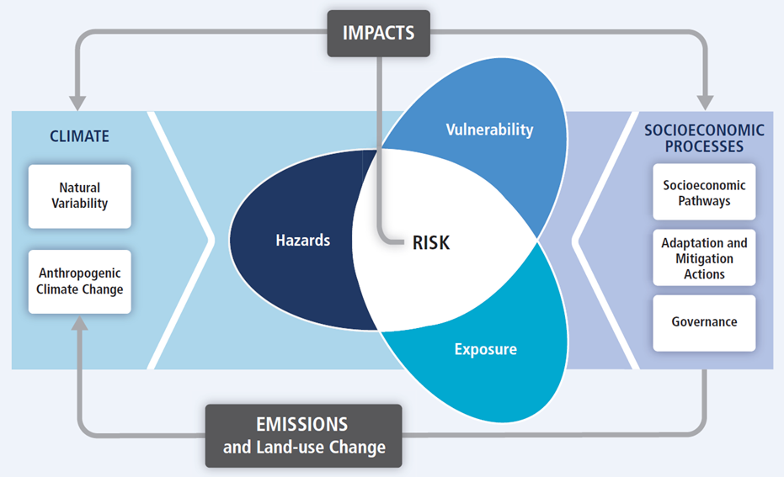
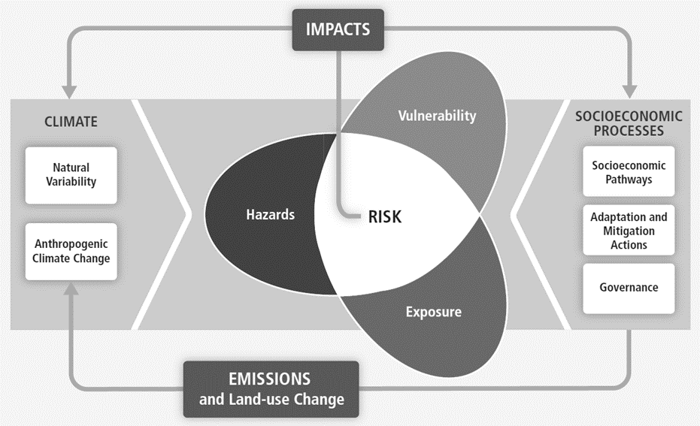
3 Defining adaptation actions
Understanding the RVA and first prioritisation
ADAPTIVE CAPACITY
Objective: AVOID IMPACTS
For this, the risks need to be reduced
There are four items where to act:
  Hazards: “mainly” impacted by mitigation actions
  Vulnerability: to be reduced in relation to sectors and population groups
  Exposure: to be reduced in relation to sectors and population groups
  Adaptive capacity: to be increased
SECTORS
POPULATION GROUPS
SECTORS
POPULATION GROUPS
Notes:
SELF GOVERNING
Energy management of local authority estate
Demonstration projects in public facilities
ENABLING
Partnership with transport service providers (e.g. integrated ticketing and charging)
PROVISION
Incentives and grants to local energy generation (e.g. Use public funds (also national) to leverage private and commercial investments)
REGULATION
- Mandatory standards and building codes (e.g. Introduce subsidies and bonus (e.g. reduction in development fees, expedited permit process or allowances for extra building floor/volume) for high efficiency buildings)
- Revision of administrative procedures for energy projects (e.g. Advantageous conditions to projects in the "Public Interest“)

Slide 9
Defining adaptation actions
Well-targeted adaptation actions
EXAMPLES
VULNERABILITY & EXPOSURE
Technical / infrastructure
Policy / regulatory
Finance
Capacity building
Social innovation
HAZARD
VULNERABLE POPULATION GROUPS
VULNERABLE SECTORS
Extreme heat
Elderly
Buildings
Building climate shelters to protect people when there is extreme heat
Standards creation for new buildings: orientation, shading, greenery
Grants for the refurbishment of buildings to make them climate proof
Awareness campaigns to ensure that citizens know how to react
Initiative to know your neighbours – partnering to ensure mutual care
Floods
Low income households
Buildings
Building barriers / protecting infrastructure against floods
Regulating city areas to restrict the construction of buildings
Grants to displace homes in highly exposed and vulnerable areas
Training architects / engineers on bdg improvements to enhance resilience against flood
Neighbourhood alarm system and first aid via mobile phone
Water scarcity
Low income households
Agriculture & forestry
Invest on tech to support alternative agricultural practices
Regulation of the agricultural practices and limiting water consumption
Incentives for farmers that deploy smart agriculture practices
Training farmers on new agricultural methods and their water impact
Generate association of farmers to share best practices
River floods
Commuters / workers
Transport
Building alternative roads to connect the city
Developing a plan for the first actions to be deployed by civil emergency
Incentives for enterprises that promote tele working
Building internal capacity of local authority to understand impact of river floods
Develop a network of stakeholders to implement first actions against a river flood impact
“Easier” to quantify, direct impacts
Generation of an enabling environment.
Also highly important, but impacts are less evident
Extreme precipitations
Rain Storms
Extreme Heat
Heat waves
Monsoon
Heavy rainfall
Heat stress
Floods and sea level rise
Flash floods
River floods
Coastal floods
Water scarcity
Wild fires
Drought
Forest fires
Water stress
Storm and wind
Land fires
Severe Wind
Tornado
Cyclone
Notes:
SELF GOVERNING
Energy management of local authority estate
Demonstration projects in public facilities
ENABLING
Partnership with transport service providers (e.g. integrated ticketing and charging)
PROVISION
Incentives and grants to local energy generation (e.g. Use public funds (also national) to leverage private and commercial investments)
REGULATION
- Mandatory standards and building codes (e.g. Introduce subsidies and bonus (e.g. reduction in development fees, expedited permit process or allowances for extra building floor/volume) for high efficiency buildings)
- Revision of administrative procedures for energy projects (e.g. Advantageous conditions to projects in the "Public Interest“)

Slide 10
Defining actions

Slide 11
Defining adaptation actions
What information should be provided to define a mitigation action
The actions should include the following elements :
A clear general description of the action
Starting and ending date
Linked adaptation goal
Corresponding adaptation hazard(s) and vulnerable sector(s)
Vulnerable population group(s)
Quantitative outcome
Actors involved
Implementation costs
Financing instruments
Monitor indicators
The scope of the action should be clear. Definition of boundaries, number of items to be implemented / addressed or surface helps to understand the scope.
Based on this, the city could consider the creation of a table to track the progress of the actions.
Adequately targeting the action and linking them to the corresponding adaptation goal, hazard, vulnerable sector and vulnerable population groups will ensure the provision of a coherent plan.
Defining a quantitative outcome is necessary to ensure reaching the target. Depending on the action, this can be represented in a number of ways.
Based on a previous stakeholder mapping, the city would need to identify for each action who are the responsible stakeholders, and who are the ones affected by the actions. Also, in the case of adaptation, vulnerable population groups are particularly important.
Like in mitigation, it is FUNDAMENTAL to reflect on the role and capacities of the local authority in the deployment of the actions.
Calculating the implementation costs of the actions is highly important, as it could determine the feasibility of some actions. The analysis of cost effectiveness (i.e. how impact per € invested) can be one way to prioritise actions.
Specific slides
BONUS: describe barriers to implementation of the actions and
corrective actions (if applicable)
Notes:
Se qualcuno avrà fatto l’esercizio a casa potrebbe riportare le proprie azioni.

Slide 12
Designing the action portifolio
Aspect | Definition | Exemples:
Impact | Measures the direct impact that: Do the adaptation actions contribute to the defined adaptation goal(s)? | Goal: Reduce the annual expected loss due to floods in the municipality by 80% by 2025 Reduce of annual expected loss ($) Numer of people reached by EWS alerts (number of people)
Costs | Identifies the total cost and relative cost. (CapEx and OpEx) | $/vulnerable households affected Total initial cost to build resilient households (CapEx); Annual cost or savings related with avoided losses (OpEx)
Feasibility | Techinical Institutional/legal framework Economic Social Other | Is the action technically ready? Are the existing legal frameworks aligned with the actions Are there funding opportunities for that? What is the cash flow? Financial instruments? Are there some specific groups affected by the action? Is the action controversial for the society? Are there safety and environmental limitations?
Co-effects and co-benefits | Identifies the deliver benefits beyond the target sector | Increase in access to basic services (healthcare, education)
Trade-offs | Identifies potential negative effects that goes beyond the target sector | Implementation of flood protection infrastructure (loss of natural haitats)

Slide 13
Monitoring the actions

Slide 14
Adaptation pillar monitoring indicators
Impact indicators (in relation to adaptation goals)
Number of vulnerable population to climate hazards [no.]
Implementation indicators (some examples in relation to individual actions)
Number of extra trees planted [no.]
Economic loss of a sector due to the impact of climate hazards (i.e. to droughts, extreme heat) [€]
Softened surface for water infiltration [m²]
Extra green roofs or façade gardens per citizen [m²]
Number of forest fires / hectares land burned [no.], [ha]
Number of buildings damaged by climate hazards (i.e. river flooding, storms) [no.]
Additional rainwater recuperation per citizen [m³]
Indicative options. Cities are encourage to identify as many indicators as possible to cover the entire action portfolio and implementation
Notes:
Impact indicators focus on the direct impacts related to an action and assess the contribution of the proposed action to the overall goal of the plan.
Indicators to track the implementation of actions focus on the parameters related with the tangible deployment of the action. Normally, these types of indicators are easier to monitor compared to impact indicators, as they quantify the primary result of an action, or the steps needed to put an action in place.

Slide 15
Exemple
Action | Heat wave awareness
Responsible body | Local authority | Time frame: 2022-2030 | Type: Knowledge and behavioral change
Resources | Own Municipal resources, EU Funding
Hazard addressed | Extreme heat
Sector addressed | Buildings
Description | the municipality develops a suite of information and awareness campaign actions aimed at informing and increasing awareness of residents on heatwaves. The campaigns focus on four stages: conceptualisation, prevention, action and promotion: (1) inform the general public about the main effects of heatwaves; (2) communicate possible measures to be taken to prevent the consequences of heatwaves, (3) explain how to act in case of health effects due to high temperatures, and (4) describe the responsible behaviours to adopt during heatwaves, such as the adequacy of working hours, the need to avoid certain activities during peak temperature hours.
Impact/Expected outcome | Reduce mortality associated with heat wave events Quantitative indicators: Mortality rate during heat waves [mortality rate]; hospitalisations due to heat waves [number]
Implementing parameters | Quantitative indicators: Number of information and awareness events [number]. People participating in the campaigns [number]
Co-benefits/Trade-offs | Quantitative indicator: Hospitalisations due to heat waves [numb
Notes:
Questi sono esempi da spiegare

Slide 16
Exemple
Action | Reinforcing river flood protection measures
Responsible body | Local authority | Time frame: 2022-2030 | Type: Physical and tecnological
Resources | EU Funding
Hazard addressed | Floods
Sector addressed | Infrastructure
Description | To prevent damages of future floods through the cleaning and expansion of the riverbed of the river to increase its capacity for dealing with high amounts of water. Through exposure maps and assessment of vulnerable assets, it was possible to identify the priority areas for implementing the actions. Significant amounts of material were taken from critical stretches of the riverbeds. Fallen trees and overgrown vegetation were removed, while construction works were carried out to strengthen bridge structures and the existing stone walls, which are particularly relevant for the security of the main bypass road above the
Impact/Expected outcome | Quantitative indicators: People/neighbourhoods affected by the floods [number of occurrence
Implementing parameters | Quantitative indicators: Volume of material removed from the riverbanks [m3]
Co-benefits/Trade-offs | Quantitative indicator: tourists visiting [number tourists/year]; investments in the municipalities [EUR]
Notes:
Questi sono esempi da spiegare

Slide 17
Conclusions
It is important to understand the local relality and have a detailed and complete Risk and Vulnerability Assessment (RVA), the design of the actions should align with the RVA and the goals
Actions on adaptation should consider not only the expected direct outcome of an action, but also all others characteristics that will be relevant for the implementation of the actions
For a good implementation, the desing of the actions should also include identify monitoring indicators, for impact and implementation.

Slide 18
Thank you
Fill in copyright information.
paula.borges-da-silveira-bezerra@ec.europa.eu
© European Union 2025
Unless otherwise noted the reuse of this presentation is authorised under the CC BY 4.0 license. For any use or reproduction of elements that are not owned by the EU, permission may need to be sought directly from the respective right holders.
Slide xx: element concerned, source: e.g. Fotolia.com; Slide xx: element concerned, source: e.g. iStock.com

