Slide 1

GUIDELINES ON
NATURE-BASED SOLUTIONS AND OTHER
ADAPTATION PRACTICES
Mr. Alejandro Jimenez
Nature- based solutions expert, Spain
2025-10-13
13 October2025
13 October2025
13 October2025

Slide 2
Presentation key Goal:
show toolkits & other contents of the Guidelines that municipalities can use to prepare adaptation projects.
Walk through the contents of the Guidelines:
Urban adaptation options
Comparing NbS with infrastructure options
Practice, definitions & tips
Climate Risk Analysis & Adaptation: Steps & Tools
Tools & Examples of NbS for climate hazards
Toolkits available for designing adaptation options
Way forward
Notes:
Guidelines Report: Methodology and tools for SECAP adaptation actions including Nature-based Solutions

Slide 3
A definition of Nature-based Solutions
During its 5th session, the United Nations Environmental Assembly (UNEA) formally adopted the definition of NbS as:
  ‘actions to protect, conserve, restore, sustainably use and manage natural or modified terrestrial, freshwater, coastal and marine ecosystems, which address social, economic and environmental challenges effectively and adaptively, while simultaneously providing human well-being, ecosystem services and resilience and biodiversity benefits.’
NbS safeguard the rights of communities and indigenous peoples.
https://www.naturebasedsolutionsinitiative.org/news/united-nations-environment-assembly-nature-based-solutions-definition/

Slide 4
Global commitments and Nature-based Solutions
All global and regional commitments: the 2030 Agenda for Sustainable Development, the Paris Agreement under UNFCCC, and Sendai Framework for Disaster Risk Reduction, advocate for:
Putting human development on a more sustainable and resilient pathway by setting adaptation and disaster risk management at the base of sustainable development; and
Providing important entry points not only to scale up Nature-based Solutions, but also to ensure greater coherence through integrated approaches for conservation, Disaster Risk Reduction and Climate Change Adaptation.
Notes:
Turkey adopted the Sendai Framework in March, 2015 and is currently an active participant in its implementation, through national strategies and regional cooperation.
Furthermore, within the UNFCCC framework, Turkey ratified the Paris Agreement in October 2021, which enabled the country to formulate both a National Adaptation Plan (NAP) and a Nationally Determined Contribution (NDC), with specific timelines and characteristics:

Slide 5
Urban Adaptation: Nature-based Solutions
Urban resilience indicators by UN-Habitat – MCR 2030
Indicator | Description | Urban relevance
% urban population in risk-prone informal areas | Measures exposure and guides upgrading priorities | Critical for equitable climate resilience
% of infrastructure built to resilient standards | Assesses adaptation in new or retrofitted structures | Green roofs, flood-proof roads
Urban green coverage per capita | Proxy for heat and flood mitigation | Supports nature-based adaptation
Access to emergency shelters or climate shelters | Key for urban response to extreme weather | Especially for low-income or elderly populations
Making Cities Resilient 2030 (MCR 2030) – see: https://mcr2030.undrr.org/who-we-are

Slide 6
Types of NbS to respond to main climate hazards
...And most important...
Notes:
Table 3

Slide 7
...Comparing NbS with grey strategies...
Climate change hazards | Mechanism of impacts | Impacts (S, E, T) | Nature-based Solutions | Alternative “Grey” strategies
Sea-level Rise | Salt-water intrusion | S, E | None (retreat) | Alternative water supplies; Desalinization;
 | Tidal inundation | S, T | None (retreat) | Sea gates, dikes, pumps;
Coastal Storms | Sea surge flooding | S, E, T | Mangrove, wetland, dune, reef restoration & protection
 | Coastal erosion | S, E, T |  | Sea walls, bank stabilization, armouring;
Inland storms – pluvial flooding | Damage from high flows | S, T | Tree canopy cover for rain interception; Green infrastructure to slow flows & to promote infiltration; | Channelization Storm drainage capacity; Pervious pavement;
 | Inundation low-lying areas | S, T | Wetland restoration Retention basins | Pumps Pervious pavement
Heat waves | Increased human exposure | S | Tree canopy cover; Parks & open space; Green roofs; | Air conditioning, misting stations, swimming pools, light-coloured & heat-resistant building materials
 | Increased demand for cooling | T
Notes:
Table 4

Slide 8
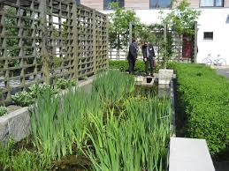
Practice & Tips 1
BOX 6 - PRACTICE
Make a list of all climate hazards affecting the city starting with the most damaging one;
Using tables 3 & 4 select the type of Nature-based Solution and “infrastructure” or “grey” solutions that may be more suitable for addressing climate hazards affecting your city;
Using table 3 identify the “hazard regulation process” needed to control each hazard;
Based on the literature, compare the approximate cost and benefits of the NbS selected with the cost and benefits of an alternative grey infrastructure option and decide which one is best;
BOX 7 - TIP
Larger-scale eco-district development projects, which encompassed various NbS solutions, including green buildings, urban green spaces and parks, water management solutions as well as blue infrastructures. Examples gathered in the database include the Eco City Augustenborg of Malmö and Hammarby Sjöstad of Stockholm, in Sweden; the Danube Eco-District project in Strasbourg, France and a Green and Sustainable Student Village in Bradford, UK. Source : Almassy, D., et al., 2018.

Slide 9
Practice & Tips 2
BOX 8 - PRACTICE:
List three (3) benefits starting with the most important one that you & your city can get from urban parks, urban lakes & from protected forests in the city and its peri-urban areas -see Table 6-.
Include benefits in terms of: (i) health & well-being; (ii) protection against -e.g. heatwave & flood-.
Include additional benefits in terms of landscaping and biodiversity.
 | Benefits from NbS such as:
NbS | Health & Wellbeing | Protection against hazard 1: e.g. heatwave | Protection against hazard 2: e.g. flood
Creating URBAN PARKS
Creating URBAN LAKES
Protecting FORESTS
Nature-based Solutions & SDGs
How do NbS Work
Steps implementing NbS in your city

Slide 10
Climate Risk Analysis (CRA) & Adaptation options (incl. NbS)
Adaptation options: aligned with: national & local Disaster Risk Reduction Strategies –;
Adaptation Target: aligned w/ NDCs & NAPs;
Adaptation options:
Infrastructure,
Nature-based Solutions
Hybrid solutions
Notes:
Clear Synergies between Adaptation (CCA) and Mitigation;
CCA may be understood as all actions leading to reducing climate risk, hence the impacts of extreme weather events.
This includes reducing vulnerabilities and exposure of citizens and urban areas to weather and climate events. Adaptation happens through:
Structural measures e.g. sea walls with benefits and impacts; or,
Nature-based Solutions e.g. restoring coastal ecosystems (estuaries, sand dunes) with benefits, co-benefits and potential social / economic impacts on alternative uses of the land instead of protecting or restoring ecosystems; or
Hybrid solutions in which nature may cooperate with grey infrastructure to withstand storm surge or prevent landslides in steep areas;
Adaptation happens designing & implementing urban policies for regulating urban development: e.g. zoning and building codes;
NBS are most likely to be effective and fair when they match the scale of the challenge, are implemented with input from diverse voices and are appropriate to specific social, cultural, ecological and technological contexts.
Mitigation is the action of reducing the emission of greenhouse gases, ultimately slowing down or stopping the warming of the planet.
Adaptation is the action of adapting to existing and expected impacts of climate change, for example higher temperatures, heavier rainfall, more frequent droughts, etc.
Both mitigation and adaptation actions need to be taken concurrently.

Slide 11
Key Definitions & Steps for CRA & NbS formulations
BOX 12 - Basic definitions
Resilience: The ability of a system, community or society exposed to hazards to resist, absorb, accommodate to and recover from the effects of a hazard in a timely and efficient manner, including through the preservation and restoration of its essential basic structures and functions.
Underlying disaster risk drivers: Processes or conditions, often development-related that influence the level of disaster risk by increasing levels of exposure and vulnerability or reducing capacity.
Disaster Risk: The potential loss of life, injury, destroyed or damaged assets which could occur to a system, society or a community in a specific period of time, determined probabilistically as a function of hazards, exposure, vulnerability and capacity.
Disaster: A serious disruption of the functioning of a community or a society involving widespread human, material, economic or environmental losses and impacts which exceeds the ability of the affected community or society to cope using its own resources.
Disaster risk reduction: the concept of reducing disaster risks through systematic efforts to analyze and manage the causal factors of disasters, including through reduced exposure to hazards, lessened vulnerability of people and property, wise management of land and the environment, and improved preparedness for adverse events.
Source: UNISDR, 2009; United Nations, 2016
Each of the 6 steps: include Practices & Toolkits

Slide 12
Summary of key Steps: mainstreaming into UPT & Tool for estimating cost& benf of adaptation options
BOX 21 – PRACTICE
Do it simply using some basic tools
Start by listing main climate hazards that generate losses and damages in the city and identifying the most affected people and the worst impacted roads, bridges, buildings, neighborhoods and zones;
Then, proceed to mapping zones at risk as well as green areas (parks, forests, gardens, etc.) ...
Check historical ecosystems—try to learn what the area looked like before the city was built. Rivers, creeks, and natural plants can guide smart planning, especially when trying to manage floods. ..s.
Find useful data—see if national agencies, universities, or local organizations have information or maps you can use.. If your city lacks land maps, tools like the Urban Atlas or CORINE Land Cover data (especially in Europe) can be helpful.
Suggest a list of adaptation actions including NbS;
Discuss adaptation actions and select the most suitable ones along with stakeholders;
Estimate Cost & Benefit of the different adaptation actions;
Prioritize adaptation actions for the city and look for sustainable sources of funding;
Identify the best Urban Planning Tool (UPT) to integrate climate change adaptation considerations;
Notes:
Source: Boris Van Zaten et al.2023
Evaluating the costs of any intervention, including NBS, is critical when comparing potential alternative solutions. Across the life cycle of a NBS for climate resilience project, there are capital expenditures (CAPEX)—including the costs of design, planning, and construction—and operating expenses (OPEX), including the costs of monitoring, maintenance, and operation of the NBS to sustain its benefits over time. Opportunity costs, transaction costs, and costs associated with negative externalities and disservices should also be contemplated

Slide 13
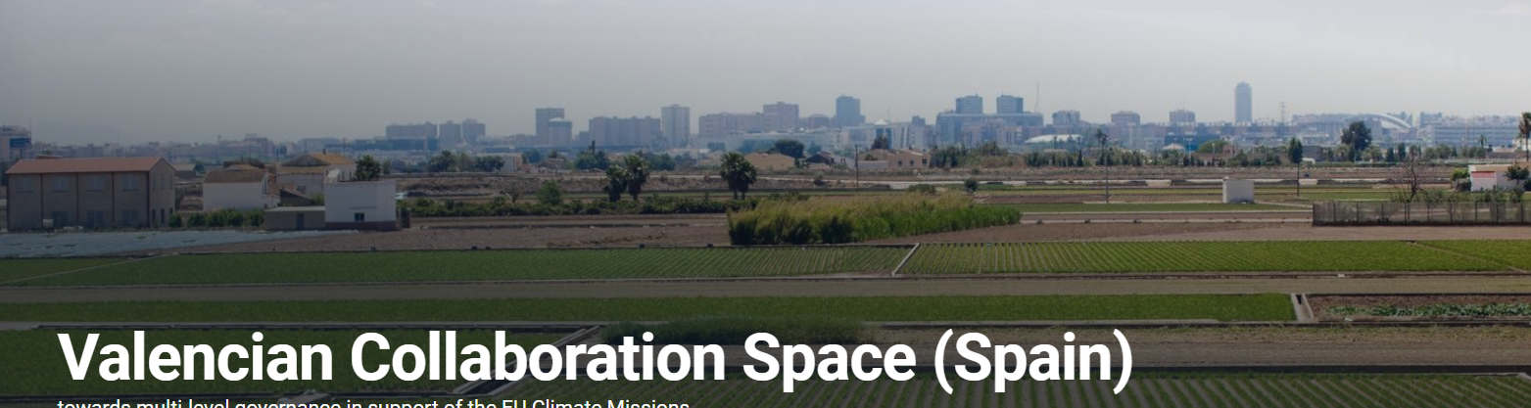

Slide 14
Tools & Examples 1: Adapting to Floods
BOX 25 – TOOL- The flood Adapt Tool
Source: https://reachout-cities.eu/post_type_toolkit/floodadapt-tool/
The FloodAdapt tool is a decision support tool intended to accelerate climate adaptation actions by making it easier for local and regional agencies to understand their flood risk under different future conditions. FloodAdapt can be used to assess compound flooding, that means any combination of marine, rainfall and riverine flooding, with or without the added effects of future sea level rise, changes in rainfall patterns and storminess and socio-economic developments.
The user interface of the FloodAdapt tool makes powerful and efficient flood hazard and impact models easily accessible to users without a computational modeling background. It helps users to define, simulate and visualize flooding scenarios and their impacts and to explore effective strategies to reduce flood risk.
BOX 26 - Example: Adapting to floods in Valencia, Spain
Source: https://climate-adapt.eea.europa.eu/en/mission/solutions/mission-case-studies/valencian-multi-level-collaboration-space
In October 2024, Valencia experienced catastrophic floods resulting from exceptional rainfall, leading to significant loss of life and property damage. This event highlighted the city's vulnerability to extreme weather events exacerbated by climate change.
In response, Valencia has initiated several measures to enhance its resilience against future flooding:
Integrated Climate Strategies: The city is developing a methodological framework that combines adaptation and mitigation strategies. This approach aims to support decision-makers in implementing effective climate actions. In Valencia, climate adaptation is now gaining prominence after years of mitigation being the primary focus of climate policy and implementation.
Learning from European Initiatives: Valencia is studying pilot projects across Europe to identify best practices and innovative solutions for flood management and climate adaptation.
Infrastructure Improvements: Efforts are underway to upgrade drainage systems and implement nature-based solutions to manage storm water more effectively.
In Valencia, authorities are establishing a multi-level ‘collaboration space’ to enable vertical and horizontal coordination and drive the EU Missions in an integrated manner. The objectives of this multi-level collaboration space include, among others:
Improving the resilience to the impacts of climate change by, for instance adapting existing buildings and resizing bridges;
Supporting the integration and mainstreaming of climate adaptation into municipal and regional planning, so development can be restricted in high-risk flood zones;;

Slide 15
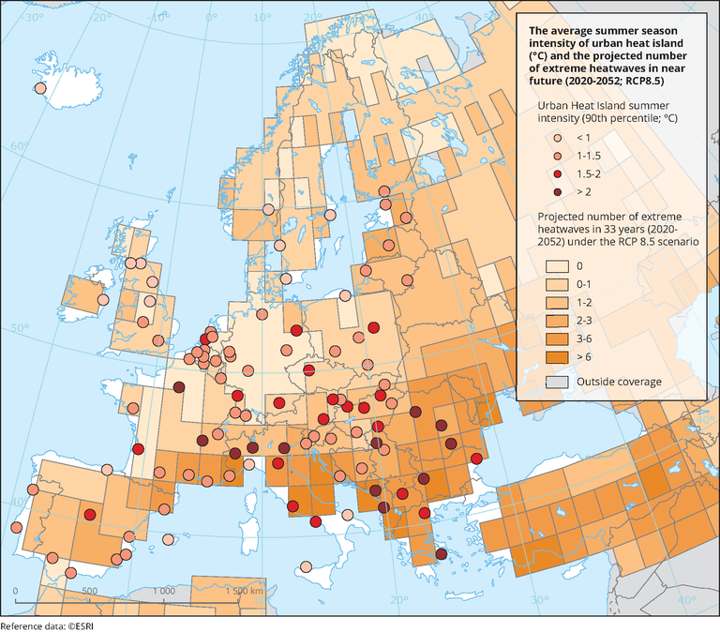

Slide 16
Tools & Examples 2: Adapting to Hetwaves
BOX 28 - Example: Adapting to heatwaves in Istanbul and Turin
Istanbul, Turkey
Istanbul is experiencing intensified heatwaves, exacerbated by the urban heat island effect.
The Turkish State Meteorological Service (TSMS) defines a heatwave as high temperatures and high humidity spanning a long time period. As for the standard set for Turkey, it is defined as “an extended period during which temperatures exceed the highest average temperature by 10 °C or more, and are accompanied by extreme humidity”.
In Turkey, 2020 was recorded as the third warmest year post-1970s. Projections indicate that, under worst-case scenarios, the city's average temperature could rise by 4.5°C due to climate change, with urban heat islands adding another 1–2°C.
Adaptation Measures:
Climate Action Plan: Istanbul has developed a Climate Change Action Plan focusing on enhancing urban resilience, including strategies to mitigate heat-related risks.
Green Infrastructure: Efforts are underway to increase green spaces and implement xeriscaping—a landscaping method that reduces or eliminates the need for supplemental water from irrigation—to combat rising temperatures.
Source (i) Istambul: https://www.env-health.org/wp-content/uploads/2021/09/Turkey_Heatwaves_Briefing_EN.pdf
Source (ii) Turin, Italy: https://climate-adapt.eea.europa.eu/en/observatory/policy-context/country-profiles/italy
BOX 27 – TOOL- Thermal Assessment Tool
Source:https://reachout-cities.eu/post_type_toolkit/thermal-assessment-tool/
The Thermal Assessment Tool (TAT) assesses and visualizes the thermal behavior of regions and cities in Europe during episodes of extreme heat to better understand these phenomena. So far, it has been tested in Logroño, Milano & Athens.
The tool allows end-users and decision makers to easily visualize how long, intense and frequent extreme heat events will be in the coming decades considering the intermediate (RCP4.5) and very high (RCP8.5) emissions scenarios. This raises awareness for citizens and supports governments to prepare and protect the city through effective policy making.

Slide 17
Tools & Examples 3: Adapting to SLR
BOX 30 - Example: adapting to SLR in Venice, Italy
Source : Anzidei, M., et al., 2024.
The coastal city of Venice is affected by the combined effects of SLR, natural and anthropogenic land subsidence, as well as frequent events of “acqua alta” (extreme high-water levels due to the combined effect of astronomic and meteorological tides) and by a general sea level anomaly (with respect to the baseline period 1993–2020).
The repercussions of Extreme Sea Level (ESL) events in Venice are substantial, leading to significant damage to the city's cultural and economic heritage. The inundation of streets and buildings, along with the widespread destruction of artworks and landmarks, such as the historic St. Mark's Basilica, emphasizes the critical need for proactive measures
Over the past century, sea levels in Venice have risen by approximately 26 centimeters, with projections indicating further increases of up to 80 cm by 2100 under high-emission scenarios.
Key Adaptation Measures:
MOSE Flood Barrier System: Venice has implemented the MOSE (Modulo Sperimentale ElettromeCCanico) project, consisting of 78 mobile gates installed at the lagoon's inlets. These gates can be raised to protect the city from high tides and storm surges;
Infrastructure Elevation: Efforts are underway to raise quaysides and pavements, particularly in vulnerable areas like Piazza San Marco, to mitigate flooding during high tides;
Monitoring and Research: Continuous monitoring of sea-level trends and subsidence is conducted to inform future adaptation strategies;

Slide 18

Tools & Examples 4:
Adapting to Storms
Adapting to Wildfires
Adapting Infrastructure
Notes:
SECAP: Adaptation Actions (AA) suggested template
AA designed to respond to climate hazards with higher impacts;
AA infrastructure, NbS or Hybrid;
NbS: designed based on e.g. amount of water to be stored; slope area to be stabilized; city blocks to be cooled off;
NbS: may complement each other: Sponge-City Initiative & SUDS;
NbS: with CO2 capture benefits for Mitigating Climate Change;
Hybrid options: increasing applications;
In brief: data is needed: a climate-risk profile and data on climate & environment;
The TEMPLATE supplied:
AA infrastructure, NbS or Hybrid:
Infrastructure: always available, high cost, collateral damage or impacts;
NbS: depending on space availability for e.g. planting trees or greening the city;
NbS: depending on the knowledge regarding ecosystem services of certain natural assets: the function of e.g. ponds and wetlands for capturing and storing water after heavy rains; or trees, acting as wind breaks for cold weather or as cooling systems in cities against UHI effect; or as protection against landslides in association with other types of vegetation;
Hybrid: depending on the situation, some infrastructure may be a good help to nature. E.g. in very steep slopes – landslide prone areas;
The NbS Evidence Platform: https://www.naturebasedsolutionsevidence.info
How effective are NbS to CCA: https://www.naturebasedsolutionsinitiative.org/wp-content/uploads/2018/09/AreNBSeffective.pdf
Biodiversity outcomes of NbS for CCA: https://www.frontiersin.org/journals/environmental-science/articles/10.3389/fenvs.2022.905767/full
NbS Evidence for Hazard Risk Reduction & Eco Services: https://www.ida.org/-/media/feature/publications/n/na/nature-based-solutions-evidence-for-hazard-risk-reduction-and-ecosystem-services/3003750.ashx

Slide 19
Chapter 4 on Toolkits:
Adaptation options
Opportunity Mapping Tool with opportunity map datasets
NbS Opportunity Scan Tool
InVEST for urban flood planning Tool
Toolbox for Moniroting & Evaluation
Notes:
SECAP: Adaptation Actions (AA) suggested template
AA designed to respond to climate hazards with higher impacts;
AA infrastructure, NbS or Hybrid;
NbS: designed based on e.g. amount of water to be stored; slope area to be stabilized; city blocks to be cooled off;
NbS: may complement each other: Sponge-City Initiative & SUDS;
NbS: with CO2 capture benefits for Mitigating Climate Change;
Hybrid options: increasing applications;
In brief: data is needed: a climate-risk profile and data on climate & environment;
The TEMPLATE supplied:
AA infrastructure, NbS or Hybrid:
Infrastructure: always available, high cost, collateral damage or impacts;
NbS: depending on space availability for e.g. planting trees or greening the city;
NbS: depending on the knowledge regarding ecosystem services of certain natural assets: the function of e.g. ponds and wetlands for capturing and storing water after heavy rains; or trees, acting as wind breaks for cold weather or as cooling systems in cities against UHI effect; or as protection against landslides in association with other types of vegetation;
Hybrid: depending on the situation, some infrastructure may be a good help to nature. E.g. in very steep slopes – landslide prone areas;
The NbS Evidence Platform: https://www.naturebasedsolutionsevidence.info
How effective are NbS to CCA: https://www.naturebasedsolutionsinitiative.org/wp-content/uploads/2018/09/AreNBSeffective.pdf
Biodiversity outcomes of NbS for CCA: https://www.frontiersin.org/journals/environmental-science/articles/10.3389/fenvs.2022.905767/full
NbS Evidence for Hazard Risk Reduction & Eco Services: https://www.ida.org/-/media/feature/publications/n/na/nature-based-solutions-evidence-for-hazard-risk-reduction-and-ecosystem-services/3003750.ashx

Slide 20
ACC clearly overlaps with DRR & Ecosystem Management & Restoration
An enabling environment for ACC starts with advancing CRA & identifying most vulnerable areas & communities to climate hazards;
Institutions in charge of urban planning to adopt a climate-informed approach that values nature’s & NbS benefits & costs;
NbS to be mainstreamed for having: Climate-smart Urban Planning;
NbS must build on multi-stakeholder & multi-sector planning;
Local governments shall seek, generate and unlock finance for ACC & NbS by designing & updating fund raising mechanisms at the municipal level & e.g. engaging the private sector
Notes:
Adaptation actions: Infrastructure, Nature-based & Hybrid: impacts, benefits and cost-effectiveness;
Ecosystems and their services, though often overlooked or degraded, can provide multiple hazard regulating functions such as coastal and surface flood regulation, temperature regulation and erosion control.
Adaptation actions in synergy with Mitigation actions : particularly NbS dealing with regreening strategies of the cities: green roofs and facades; Ecological corridors; Parks (sponge parks) – initiatives that integrate trees and vegetation in the urban landscape and store Greenhouse Gazes;
NbS deliver a number of benefits for mitigation, environment, livelihoods & health particularly in urban environments: cost-effectiveness and SDGs;
Designing adaptation actions: information – maps; data, models and scenarios; the more data we have on specific location of main hazards and their estimated economical impacts and the losses and damages for each hazard, the better we can come up with more precise Adaptation Actions; consulting with local authorities and the inhabitants of the vulnerable districts is key, in order to design AA that can be implemented, followed up, maintained in time and investment and leave lessons learned to city dwellers and city planners;
Adaptation targets: realistic and in synergy with DRR goals at scale;

